Slide 1
The Prof Said What?!?!
Navigating the Intersection of
Academic Freedom and Public-Employee
Speech Rights at Public Universities
Institute for Academic Leadership
Chairs Workshop, Howey-in-the-Hills, Florida
September 15, 2025 Copyright © 2025 Clay Calvert

Slide 2
Roadmap
• 3 Professorial Speech Cases
• Conceptions of Academic Freedom
• Public-Employee Speech Rights
• Return to Analyze the 3 Cases

Slide 3
Reges v. Cauce (W.D. Wash. 2024)
The Snarky, Syllabus-Included
Land Acknowledgment
Statement

Slide 4
Reges v. Cauce (W.D. Wash. 2024)
“I acknowledge that by the labor theory of property the Coast Salish people can claim historical ownership of almost none of the land currently occupied by the University of Washington.”

Slide 5
Gruber v. Tennessee Tech. (6th Cir. 2024)
The Racist-Branding,
On-Campus Posted Flyers

Slide 6
Gruber v. Tennessee Tech. (6th Cir. 2024)
“This racist college professor thought it would be a great idea to help start a Tennessee Tech chapter for this national hate group, where racist students can unite to harass, threaten, intimidate, and terrorize persons of color, feminists, liberals, and the like, especially their teachers.”

Slide 7
Corlett v. Tong (S.D. Cal. 2025)
The N-Word Using,
Gender-Slurring Professor

Slide 8
Corlett v. Tong (S.D. Cal. 2025)
• N-Word repeatedly used by professor in an entry-level, gen-ed philosophy class at SDSU (Critical Thinking and Composition) to explore the “use-mention distinction.”

Slide 9
Corlett v. Tong (S.D. Cal. 2025)
•Also used “p---y” and “bitch” in an upper-division and grad-level philosophy course (Political Philosophy) to refer to people or groups of people as weak or not assertive.

Slide 10
Academic Freedom
Professional v. Legal
Norm Right
• AAUP Statements • Judicial Opinions
• CBAs (Contracts)

Slide 11

“the freedom of a teacher or researcher in higher education to investigate and discuss the issues in his or her academic field, and to teach or publish findings without interference from political figures, boards of trustees, donors, or other entities.”
https://www.aaup.org/programs/academic-freedom/faqs-academic-freedom

Slide 12
AAUP’s 1940 Statement of Principles on Academic Freedom
“Teachers are entitled to freedom in the classroom in discussing their subject, but they should be careful not to introduce into their teaching controversial matter which has no relation to their subject.”

Slide 13
Legal Perspectives on
Academic Freedom
• Rhetorically Rich, Doctrinally Deficient
• First Amendment Right or Value?
• Institutional Right or Individual Right?

Slide 14
Rhetorically Rich
Two aging subversive persons and loyalty oath cases involving
Profs. Paul Sweezy (Marxist economist) & Harry Keyishian (English professor).

Slide 15
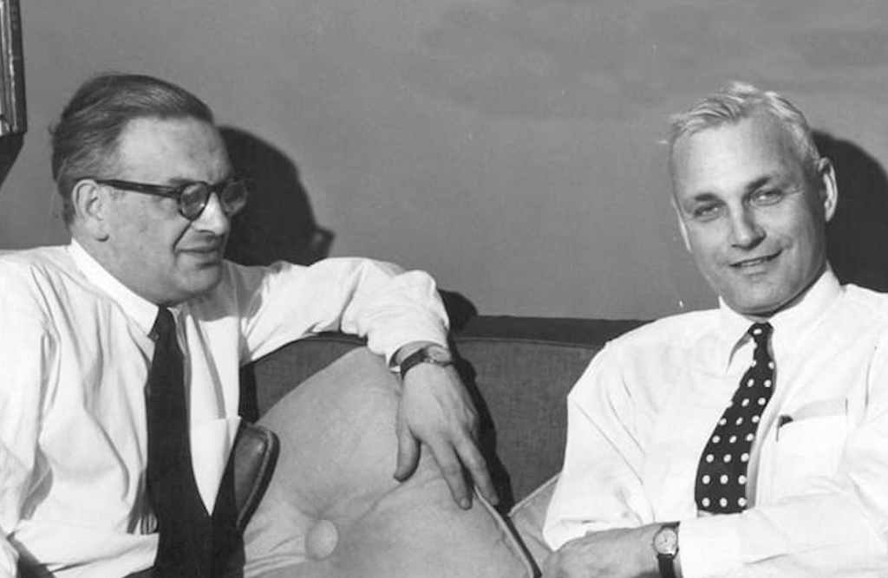
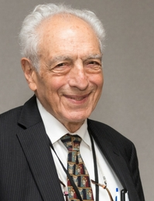
Paul Sweezy (L, facing camera)
& Harry Keyishian (R)

Slide 16
Sweezy v. New Hampshire (1957)
“The essentiality of freedom in the community of American universities is almost self-evident. No one should underestimate the vital role in a democracy that is played by those who guide and train our youth.”

Slide 17
Sweezy v. New Hampshire (1957)
“To impose any strait jacket upon the intellectual leaders in our colleges and universities would imperil the future of our Nation.”

Slide 18
Frankfurter’s Concurrence
4 Essential Freedoms of a University:
To determine for itself . . .
1) who may teach;
2) what may be taught;
3) how it shall be taught; and
4) who may be admitted to study.

Slide 19
Keyishian v. Bd. of Regents (1967)
“Our Nation is deeply committed to safeguarding academic freedom, which is of transcendent value to all of us and not merely to the teachers concerned.”

Slide 20
Keyishian v. Bd. of Regents (1967)
“That freedom is therefore a special concern of the First Amendment, which does not tolerate laws that cast a pall of orthodoxy over the classroom.”

Slide 21
Doctrinally Deficient
“At present . . . the doctrine of academic freedom stands in a state of shocking disarray and incoherence.” Robert Post

Slide 22
Two Strands of Legal Doctrines
I. Academic Freedom
• “special concern” of the First Amendment
• “constitutional value” + “transcendent value”
• “restrained judicial review” of decisions
II. Freedom of Speech
• Public Institution v. Private Institution
• Professors & Public-Employee Speech Rights
• Speaking Inside the Classroom
• Speaking Outside the Classroom

Slide 23
Public-Employee Speech Rights:
Pickering/Connick/Garcetti Issues
1. Speaking as a . . .
Private Citizen or Pursuant to Job Duties?*
2. Speaking about a matter of . . .
Personal Interest or Public Concern?
3. Weigh Competing Interests
[Depending on Answers to 1 & 2]
*Academic Freedom Exception/Carveout to No. 1?

Slide 24
Private Citizen / Public Concern
When A Public Employee Is Most Protected
“So long as employees are speaking as citizens about matters of public concern, they must face only those speech restrictions that are necessary for their employers to operate efficiently and effectively.” Garcetti v. Ceballos (2006)

Slide 25
Matters of Public Concern
Speech that can “be fairly considered as
relating to any matter of political, social,
or other concern to the community”
OR
is “subject of legitimate news interest;
that is, a subject of general interest and of
value and concern to the public.”

Slide 26
Garcetti v. Ceballos (2006)
Bad News
“[W]hen public employees make statements pursuant to their official duties, the employees are not speaking as citizens for First Amendment purposes, and the Constitution does not insulate their communications from employer discipline.”

Slide 27
Garcetti v. Ceballos (2006)
Good News
“There is some argument that expression related to academic scholarship OR classroom instruction implicates additional constitutional interests that are not fully accounted for by this Court’s customary employee-speech jurisprudence.”

Slide 28
Garcetti v. Ceballos (2006)
“We need not . . . decide whether the analysis we conduct today would apply in the same manner to a case involving speech related to scholarship OR teaching.”

Slide 29
Lower Courts Post Garcetti
Five federal appellate courts hold that Garcetti’s rule does NOT apply to classroom teaching and academic writing at public universities (2nd, 4th, 5th, 6th & 9th Circuits). Profs possess qualified First Amendment speech rights in these two contexts. Amounts to an academic freedom exception/carveout.

Slide 30
Public-Employee Speech Rights:
Pickering/Connick/Garcetti Issues
1. Speaking as a . . .
Private Citizen or Pursuant to Job Duties?*
2. Speaking about a matter of . . .
Personal Interest or Public Concern?
3. Weigh Competing Interests
[Depending on Answers to 1 & 2]
*Academic Freedom Exception/Carveout to No. 1

Slide 31

Reges v. Cauce (2024)
Protagonist Professorial Plaintiff
Stuart Reges
Teaching Professor
Paul G. Allen School of Computer Science & Engineering
University of Washington

Slide 32
Reges v. Cauce (W.D. Wash. 2024)
Object of Plaintiff’s Ire
UW Allen School’s Suggested Syllabus
“Indigenous Land Acknowledgment Statement”

Slide 33
Reges v. Cauce (W.D. Wash. 2024)
Suggested (“Best Practices”) Syllabus
“Indigenous Land Acknowledgment Statement”
“The University of Washington acknowledges the Coast Salish peoples of this land, the land which touches the shared waters of all tribes and bands within the Suquamish, Tulalip and Muckleshoot nations.”

Slide 34
Reges v. Cauce (W.D. Wash. 2024)
Statement Reges Includes in His Syllabus
(a required course for some majors)
“I acknowledge that by the labor theory of property the Coast Salish people can claim historical ownership of almost none of the land currently occupied by the University of Washington.”

Slide 35
Reges v. Cauce (W.D. Wash. 2024)
Reaction to Syllabus Statement
“Students, faculty, staff, and teaching assistants contacted UW administrators. . . The Allen School’s recruiter for diversity and access . . . expressed concern to Defendant Balazinska* that Plaintiff’s statement undermined their function within the Allen School.”
* Director of the Allen School

Slide 36
Reges v. Cauce (W.D. Wash. 2024)
Reaction to Syllabus Statement
“Multiple Native American students expressed feelings of being targeted by the statement, and one felt compelled to drop out of UW.”

Slide 37
Reges v. Cauce (W.D. Wash. 2024)
Reaction to Syllabus Statement
Union representing Allen School TAs files a complaint, alleging statement violates an antidiscrimination provision in the CBA.

Slide 38
Reges v. Cauce (W.D. Wash. 2024)
Response from Administration
• Created alternative section with a different instructor
• About 170 of about 500 students transfer to it (the alternative section meets at 8:00 a.m.)
• After formal investigation, Reges warned that if he includes his statement again, it will be treated as an intentional violation of UW faculty code.
•Reges intends to include it again

Slide 39
Reges v. Cauce (W.D. Wash. 2024)
Reges Files Lawsuit
(FIRE represents)
First Amendment Retaliation Claim
1) Engaged in protected speech
2) Suffered adverse employment action
3) Protected speech was a substantial or motivating factor for the adverse employment action

Slide 40
Reges v. Cauce (W.D. Wash. 2024)
Does Reges Prevail Against
UW’s Motion for SJ on
the Retaliation Claim?

Slide 41
Reges v. Cauce (W.D. Wash. 2024)
No: Reges Loses
• Syllabus Statement Involves a Matter of
Public Concern . . . BUT . . .
• Balance of Interests Tips in UW’s Favor
(UW had burden of proving) . . . Thus Reges
• Did NOT engage in protected speech.

Slide 42
Reges v. Cauce (W.D. Wash. 2024)
Balancing Analysis
“While offense alone does not amount to a legitimate interest to justify limiting speech, mitigating interference with students’ studies and ability to learn can be such an interest.”

Slide 43
Reges v. Cauce (W.D. Wash. 2024)
Balancing Analysis
“Promoting workplace efficiency and avoiding workplace disruption is a valid government interest that can justify speech restrictions.”

Slide 44
Reges v. Cauce (W.D. Wash. 2024)
Disruptions to:
1. Staff Functions: Recruiter for Diversity and Access; harmed in recruiting “native students” (a longtime goal to increase recruitment at UW and Allen School).

Slide 45
Reges v. Cauce (W.D. Wash. 2024)
Disruptions to:
2. Teaching Assistants: Union expressed TAs’ concern they didn’t feel comfortable mentioning their own views on topics related to land acknowledgments and DEI, fearing retaliation by Reges.

Slide 46
Reges v. Cauce (W.D. Wash. 2024)
Disruptions to:
3. Students & UW Community: Complaints from students; 170 of 500 switched to an 8:00 a.m. section; administrators received reports of students, including Native students, feeling unwelcome, intimidated, despised, and targeted, with one dropping out.

Slide 47
Reges v. Cauce (W.D. Wash. 2024)
Time, Place & Manner of Speech
• Syllabus for an introductory class; mandatory for some majors.
• UW allowed him to post his statement next to his office door and in his email signature block.

Slide 48
Reges v. Cauce (W.D. Wash. 2024)
Conclusion
Evidence “indicates that the statement interfered with the performance of Plaintiff’s duties as an instructor. Because promoting workplace efficiency and avoiding workplace disruption is a valid government interest that can justify speech restrictions . . . the Court concludes . . .

Slide 49
Reges v. Cauce (W.D. Wash. 2024)
Conclusion
Defendants’ interests in mitigating disruption outweigh Plaintiff’s interest here.”
• Grants UW’s SJ motion against Reges’s First Amendment retaliation claim.
• On appeal to the Ninth Circuit; heard oral arguments on May 15, 2025.

Slide 50
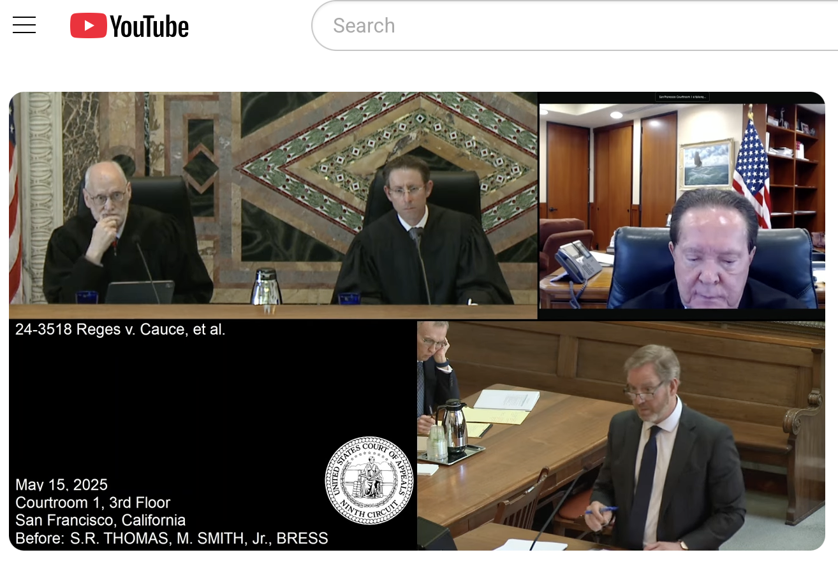
Reges v. Cauce (Oral Argument in 9th Circuit)

Slide 51
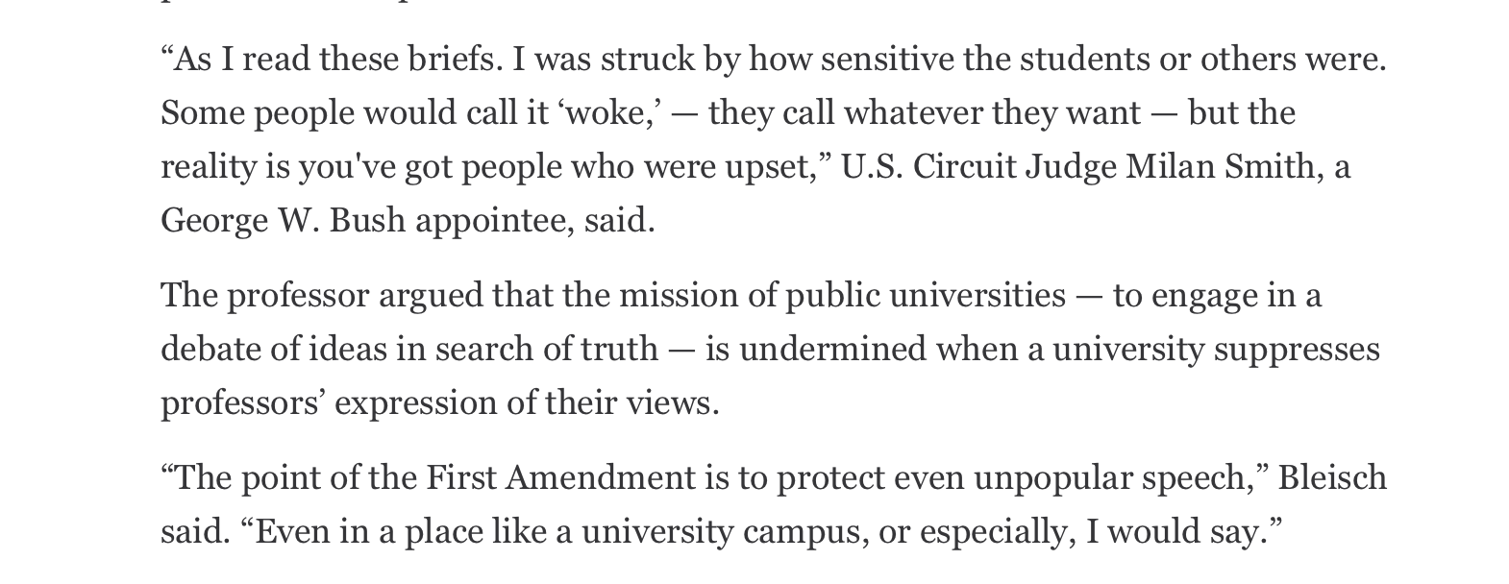
From “Courthouse News Service” Article

Slide 52
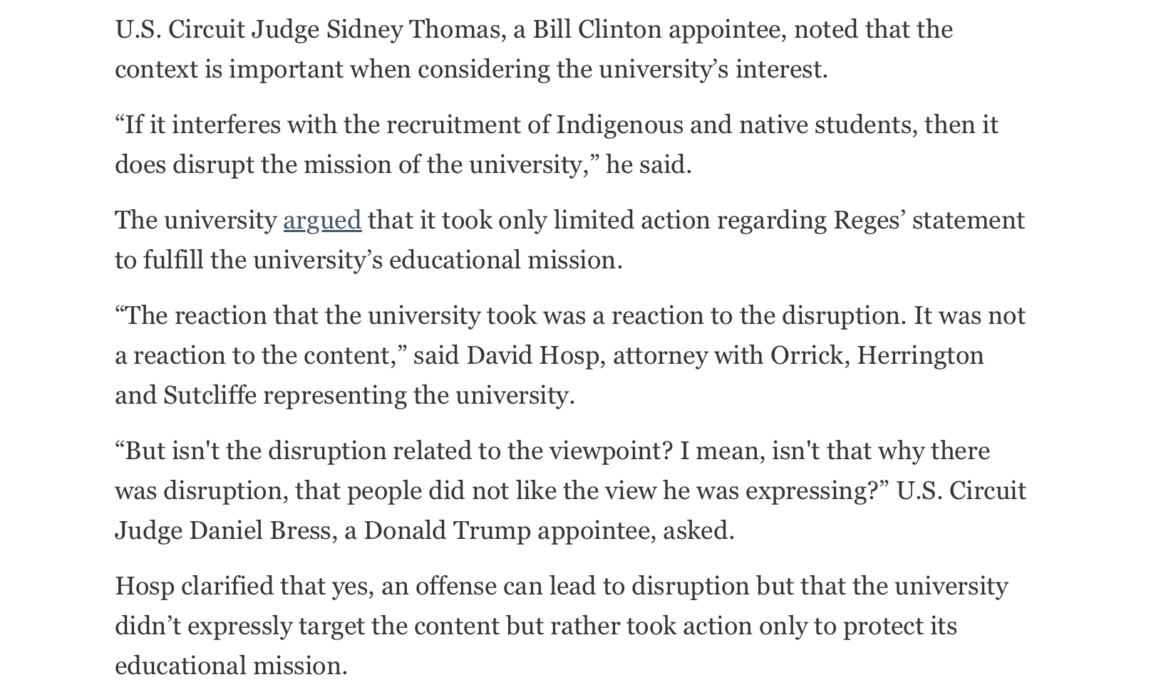
From “Courthouse News Service” Article

Slide 53
Reges v. Cauce
• Current Status: The U.S. Court of Appeals for the Ninth Circuit had not issued a decision in the case as of September 4, 2025.
• Prediction: The Ninth Circuit will reverse in favor of Reges by a 2-1 decision; UW will then ask for a rehearing en banc that will be granted.

Slide 54

Gruber v. Tennessee Tech. (2024)
Protagonist Professorial Plaintiffs
Julia Gruber & Andrew Smith
Professors,
Tennessee Technological University (TTU)

Slide 55

Gruber v. Tennessee Tech. (2024)
Target of Plaintiffs’ Ire
Professor Andrew “AJ” Donadio

Slide 56
Gruber v. Tennessee Tech. (2024)
What Did Gruber & Smith Do?
• Distributed flyers on campus
• Label Donadio a “racist college professor”
• Label Turning Point USA a “hate group”
for “racist students” (Donadio is advisor)

Slide 57
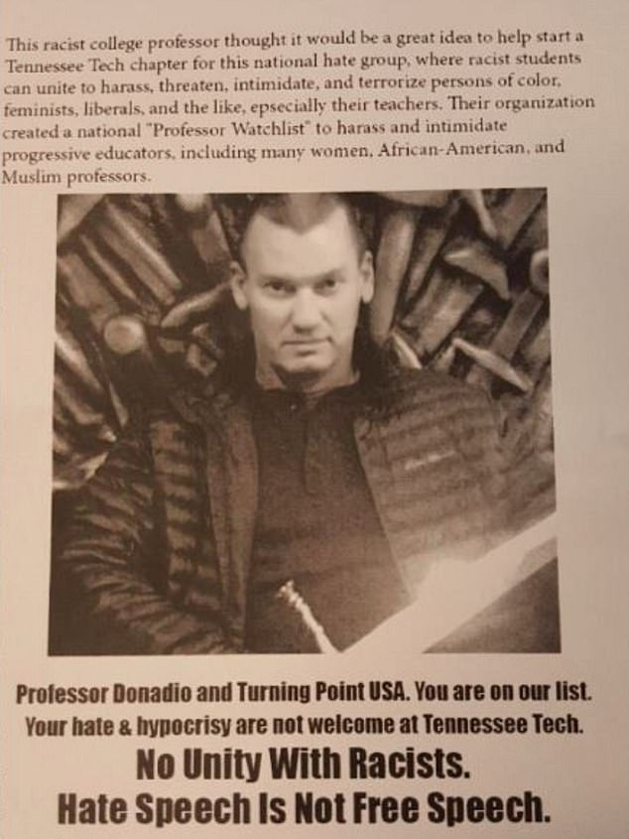
Gruber v. Tennessee Tech.
(6th Cir. 2024)

Slide 58
Gruber v. Tennessee Tech. (2024)
“This racist college professor thought it would be a great idea to help start a Tennessee Tech chapter for this national hate group, where racist students can unite to harass, threaten, intimidate, and terrorize persons of color, feminists, liberals, and the like,

Slide 59
Gruber v. Tennessee Tech. (2024)
especially their teachers. Their organization created a national ‘Professor Watchlist’ to harass and intimidate progressive educators, including many women, African-American, and Muslim professors.”

Slide 60
Gruber v. Tennessee Tech. (2024)
Gruber & Smith Are Disciplined
Violated policy re: “conduct[ing] themselves fairly, honestly, in good faith, and in accordance with the highest ethical and professional standards” and having “respect for all faculty, staff, students and the general public.”

Slide 61
Gruber v. Tennessee Tech. (2024)
Punishment/Discipline
• cannot advise student organizations
• cannot participate in study abroad activities
• ineligible for non-instructional faculty assignments
• ineligible for salary increases for a year

Slide 62
Gruber v. Tennessee Tech. (2024)
Gruber & Smith File Lawsuit
First Amendment Retaliation Claim
1) Engaged in protected speech
2) Suffered adverse employment action
3) Protected speech was a substantial or motivating
factor for the adverse employment action

Slide 63
Gruber v. Tennessee Tech. (2024)
Do Smith & Gruber
Prevail Against TTUs
Motion for SJ?

Slide 64
Gruber v. Tennessee Tech. (2024)
No: Smith & Gruber Lose
• Flyer is about a matter of public concern . . . BUT
• Balance of Interests tips in favor of Tenn. Tech.
thus they . . .
• Did NOT engage in protected speech.

Slide 65
Gruber v. Tennessee Tech. (2024)
Conclusion
“The flyers, which attacked a professor and student organization and stated that they were not welcome on campus, created a reasonable threat of disrupting TTU’s academic mission and is the type of speech that a learning institution has a strong interest in preventing.”

Slide 66
Gruber v. Tennessee Tech. (2024)
Balancing Analysis
“The accusations affected the plaintiffs’ effectiveness in the classroom. Students in [Turning Point USA] or those considering joining [it] who were taking courses with Gruber and Smith might reasonably fear the potential treatment they would receive in class due to differing political views.”

Slide 67
Gruber v. Tennessee Tech. (2024)
Balancing Analysis
“Most basically, TTU has ‘an interest in fostering a collegial educational environment.’ . . . Permitting professors to circulate flyers with personal attacks on colleagues and students undoubtably undermines that interest.”

Slide 68
Gruber v. Tennessee Tech. (2024)
Balancing Analysis
“Public employers have greater interest in regulating speech ‘at the office’ (or here on campus) than they do away from the public employers’ property. Indeed, the conclusion that the First Amendment protected the plaintiffs’ speech would mean that TTU remained powerless to remove the flyers off of its property.”

Slide 69
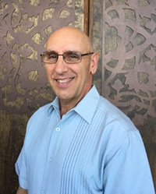
Corlett v. Tong (S.D. Cal. 2025)
Protagonist
Professorial
Plaintiff
J. Angelo Corlett
Prof. of Philosophy
& Ethics
San Diego State Univ.

Slide 70
Corlett v. Tong (S.D. Cal. 2025)
• Racial Slur: Uses N-Word in an entry-level, gen-ed philosophy class at SDSU (Critical Thinking and Composition) to explore the “use-mention distinction.”

Slide 71
Corlett v. Tong (S.D. Cal. 2025)
Use-Mention Distinction: Teaches students how to analyze the linguistic and logical distinction between ‘racial’ and ‘racist’ language, i.e., that one’s use of words entails that one believes with racist animus that the words in question apply to a particular person or group; but the mere mention of such words does not involve racist intent on the part of the speaker.

Slide 72
Corlett v. Tong (S.D. Cal. 2025)
•Gender Slurs: Used “p---y” and “bitch” in an upper-division and grad-level philosophy course (Political Philosophy) to refer to people or groups of people as weak or not assertive.

Slide 73
Corlett v. Tong (S.D. Cal. 2025)
Punishment/Discipline
• Reassignment of Classes for N-Word
• One-Semester Suspension Without Pay
for Gender-Based Slurs

Slide 74
Corlett v. Tong (S.D. Cal. 2025)
Corlett Files Lawsuit
First Amendment Retaliation Claim
1) Engaged in protected speech
2) Suffered adverse employment action
3) Protected speech was a substantial or motivating
factor for the adverse employment action

Slide 75
Corlett v. Tong (S.D. Cal. 2025)
Does Corlett Prevail Against
SDSU’s Motion for
Judgment on Pleadings
(akin to an MTD)?

Slide 76
Corlett v. Tong (S.D. Cal. 2025)
Corlett . . .
• Prevails on N-Word
• Loses on Gender Slurs

Slide 77
Corlett v. Tong (S.D. Cal. 2025)
N-Word Analysis
• Public Concern: Usage was a matter of public concern because it was “germane to the subject matter” of teaching about the “use-mention distinction” in a course called “Critical Thinking and Composition.”

Slide 78
Corlett v. Tong (S.D. Cal. 2025)
N-Word Analysis
•Balance of Interests: Because of the inherently fact-intensive nature of this inquiry, the Court can rarely perform the Pickering balancing on a motion to dismiss. Corlett thus prevails at this early stage.

Slide 79
Corlett v. Tong (S.D. Cal. 2025)
Gender Slurs Analysis
•Public Concern: Corlett failed to prove that his use of the words ‘p---y’ and ‘bitch’ was germane to the subject matter of the course called “Political Philosophy,” and thus he was NOT engaging in protected speech about a matter of public concern. Instead, he used the terms in a “derogative fashion” and “derogatory manner.”

Slide 80
Corlett v. Tong (S.D. Cal. 2025)
Takeaway re: Offensive Language
Germane to Subject Matter
vs.
Gratuitous, Derogatory Profanity

Slide 81
Summary
Subjectivity of Weighing Interests
• collegial educational environment
• workplace efficiency & disruption educ. mission
• interfere with students’ studies/learning ability
• interfere with plaintiff’s ability to teach
• time, place and manner of plaintiff’s speech

Slide 82
Thank You
Clay Calvert
Professor Emeritus
University of Florida
Nonresident Senior Fellow
American Enterprise Institute

