Slide 1
Leadership
StePPING INTO THE LEADERSHIP ROLE
Notes:
Leadership skills are developed over time
No earthshaking epiphanies today
Becoming a good leader requires devoting time to:
Read
Discuss
Think about leadership
Doing this helps develop strategies, skills, and confidence.

Slide 2
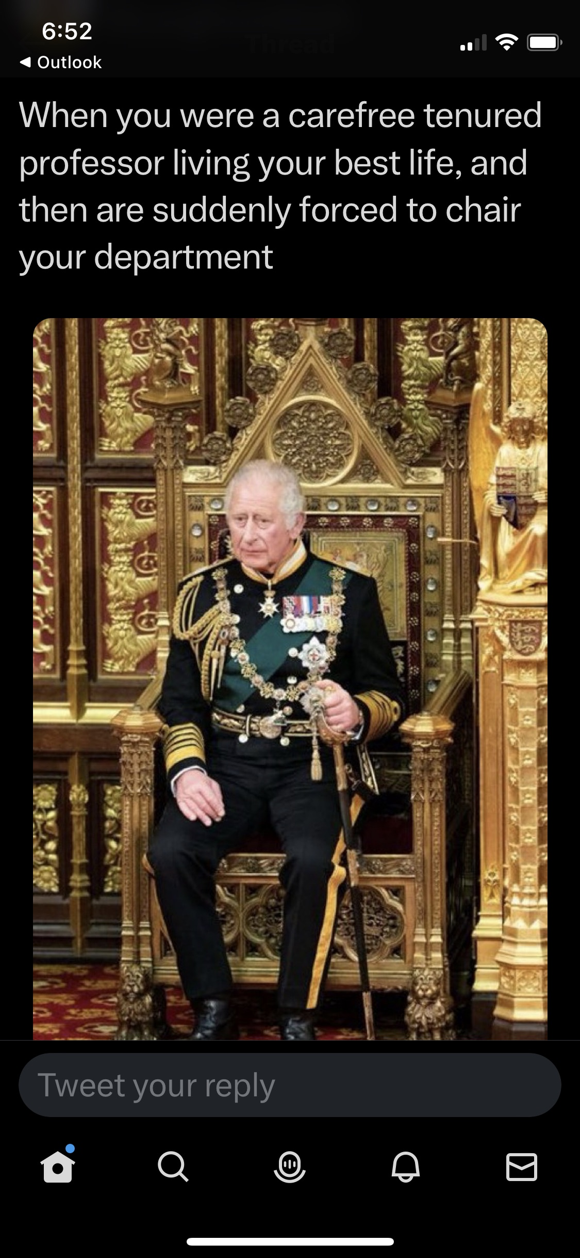

Slide 3
Takeaways
Leadership development is a process
Communication is essential
Relationships are critical
What you do as chair matters
See the big picture
Notes:
Big topic: assuming a leadership role. Many books written on this topic
I will be skimming the surface attempting to provide a foundation for the next few days.
This may be the first leadership roles that makes you the “boss” of your colleagues
(especially challenging transition if this has been your academic home for a while)
You get to deal with
Budgets
HR issues (hiring, evaluation, employee discipline)
Accreditation standards
Student issues
Middle of sometimes competing interests,
faculty,
staff,
students
upper administration
It can be a bit overwhelming
Just like any set of skills it takes time and practice to develop great leadership skills.

Slide 4
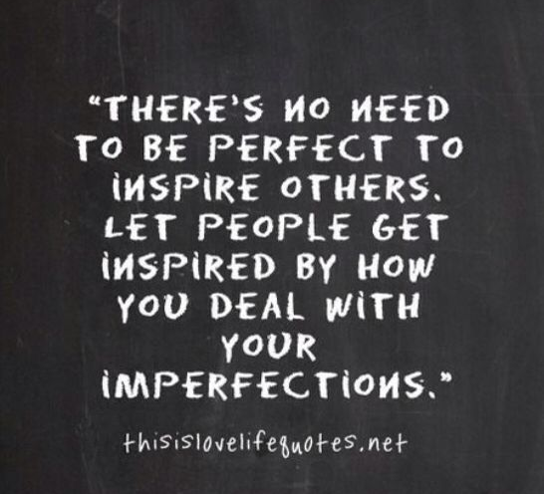
Easy Does It
Notes:
The take-home message of this slide is that being chair is a challenge, you are not perfect. Do not try to be perfect (discuss example of first time teachers and benefits of owning limitations). Genuineness is key

Slide 5
Developing Yourself as a Leader
What does leadership look like:
From your perspective?
From the student perspective
From the staff perspective?
From the faculty perspective?
From the Dean’s perspective?
Personal status vs. Vested status
Notes:
Most of us did not participate in an educational program that prepared us for being a chair.
While we may have informally developed leadership skills, it is not unusual to feel under-prepared and nervous about taking on these roles.
Just as it has been important to develop as a researcher and a teacher, it will be important to develop yourself as a leader.
Take advantage of resources and training to continue to reflect on who you are as a leader and hone your skills.

Slide 6
Your leadership style
Work to identify your style.
Your style will influence your interactions.
Your style will influence your decision-making skills.
Your style can help develop your technique.
You can’t copy someone else’s style.
Notes:
Use your time here, and when you return home, to reflect on your leadership; Shortly, you will complete a reading on leadership styles, followed by discussions in your groups. Awareness is key.

Slide 7
Lead by example
Faculty and staff will watch you….
…..and scrutinize everything you do!
what time you arrive
what time you leave
who you talk to
how you dress
how you respond to email
…and everything else you haven’t yet thought of
Notes:
Model the way – whether you like it or not, being chair has a “fishbowl” aspect to it; can’t avoid it so learn to use it for the benefit of your department.
No correct answers to when to arrive or leave or how to dress, etc. It depends – on circumstances, culture of your department. But critically important that you are aware of what you do will be watched and interpreted by others.

Slide 8
Communication is key
Listen to concerns, ideas and feedback
Be as transparent & direct as possible
Make timely (not rushed or impulsive) responses
Think before you write (remember
texts & emails are public records)
Admit mistakes
Keep notes of your actions
Notes:
Not telling you anything you don’t already know – yet communication missteps are common and sometimes very costly. Just do your best to avoid pitfalls (like how you communicate via texts, emails).

Slide 9
Teach your face to use its inside voice
Notes:
Nodding – active listening – but beware – may be interpreted as you agreeing to something that, in fact, you have not.

Slide 10
Relationships are critical
If you are new…(or not)
Get to know everyone (faculty and staff)
Take time
Listen
Get off your “turf”
If you have been there…(or not)
You are the boss
Old friendships may not work the same
You can’t do this job wanting to always be liked
Establish support outside of department
Notes:
Show of hands: New to your department (hired from outside) vs. been a member of the department (rotation, election).
Cannot overstate the impact becoming chair has on your relationships with your colleagues
really important to have a supportive group of folks in your roles because many issues you will grapple with as chair cannot/should not be discussed with faculty colleagues.

Slide 11
Celebrate Success!
The college
The department
The faculty
The students
It’s worth it!
Notes:
Celebrate and communicate successes (faculty, staff, students)
Email
Social media
Newsletters
Web articles
Faculty Meetings
Improves morale
Strengthens community
Helps with requests for resources
May help with rankings

Slide 12
See the BIG picture
Understand needs of College/University
Don’t rely just on favorites
Get used to wearing multiple hats
Knowledge gives you the ability to make decisions with confidence
Move from reactive to proactive
Notes:
Understand the needs of the college/university and how my department could/did contribute to their goals.
Avoid relying on “favorites”, creating perception of “in” crowd.
Listen with open mind, to diverse views and actually be open to changing your mind on issues;
The more you know about your department (data!) and the goals of your college/university, the greater your “power” and effectiveness.
Make friends with IR team
It takes about a year to truly get the scope of the job
Reactive to proactive

Slide 13
Prioritize Needs - Decide Course – Take Action
What is the department doing now?
Why are we doing it?
Can we do it better? How?
What does the dean expect?
Notes:
To be a good leader you need to know where you are going
Involve your colleagues; provide opportunities for them to weigh in on issues
Determine how you will know if your efforts have moved the needle

Slide 14
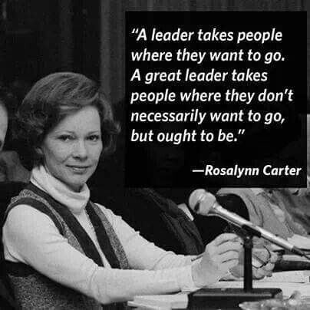
Leadership $is$ not the same as management or administration
Model the way
Inspire a shared vision
Challenge the process
Enable others to act
Encourage the heart
*Taken from “The Leadership Challenge: How to Make Extraordinary Things Happen in Organizations” by J.M. Kouzes & B.Z. Posner, 6th ed. (Hoboken, NJ: John Wiley & Sons, 2017).
Notes:
How many have received comments about going to the dark side?
Because of shared governance, leadership requires a faculty identity and perspective.
Chairs are much more than administrators or managers. Chairs are in a position to change (for the good) the trajectory, the success, of your faculty, staff and students.
ABOVE – taken from Kouzes & Posner “The Leadership Challenge” – behaviors that characterize effective leaders.
Discuss a bit about the Leadership Challenge

Slide 15
