Slide 1
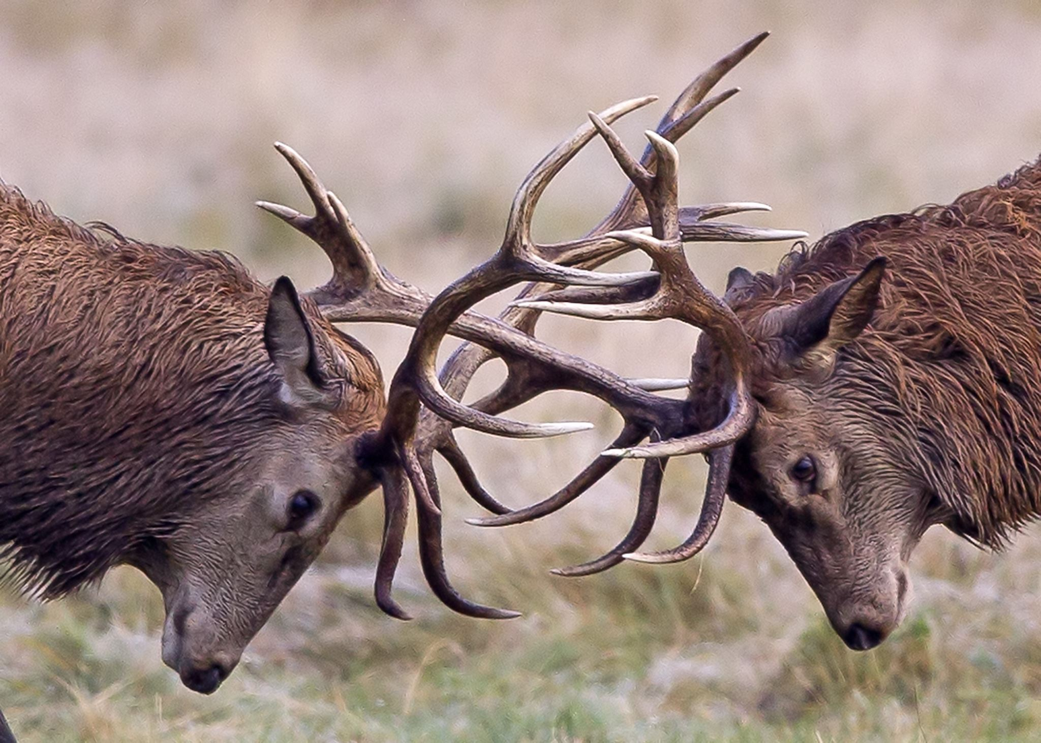
Dealing with Conflict and Maintaining Faculty (and Staff) Morale – and Your Own
Nancy A. Stanlick, Ph.D., Professor of Philosophy and Associate Dean,
College of Arts and Humanities
University of Central Florida
Institute for Academic Leadership, June 2022
Note: Many of the references and explanations of concepts and arguments presented here are derived from
professional experience in faculty grievances and complaints;
assisting Chairs and Directors with disciplinary and non-disciplinary matters and letters;
and mediating or settling disputes, where applicable.
References to publications/sources are noted as appropriate.
MS365 Stock Photo

Slide 2
Among whom does conflict occur? Everybody. And you'll need to deal with it.
Students
Faculty, Staff, Administrators
Faculty vs. faculty; vs. staff; vs. administrator; vs. rules, regulations, policies, procedures
Staff vs. staff; vs. faculty; vs. administrator; vs. institution; vs. student
Administrators vs. administrators; vs. faculty; vs. staff; vs, students; vs. institution
Student vs. Student
Student vs. Faculty
Student vs. Administrator
Student vs. Institution

Slide 3
Conflict and its Manifestations
Verbal or Written | Physical | Even more insidious
Raised voices | Slamming fists on tables | Veiled or explicit threats against a person’s professional standing
Gossip | Threats of physical violence | Creating factions for power plays
False Reporting; accusations; threats of legal or union action | Belief of one or more parties that physical violence will ensue | Promising or implying benefits to those who side with another person
Disruptions during meetings | When others feel uncomfortable in another person's mere presence | Using title or place in hierarchy as an explicit or implicit threat
Testy, grumpy, unpleasant emails
MS365 Stock Photo

Slide 4
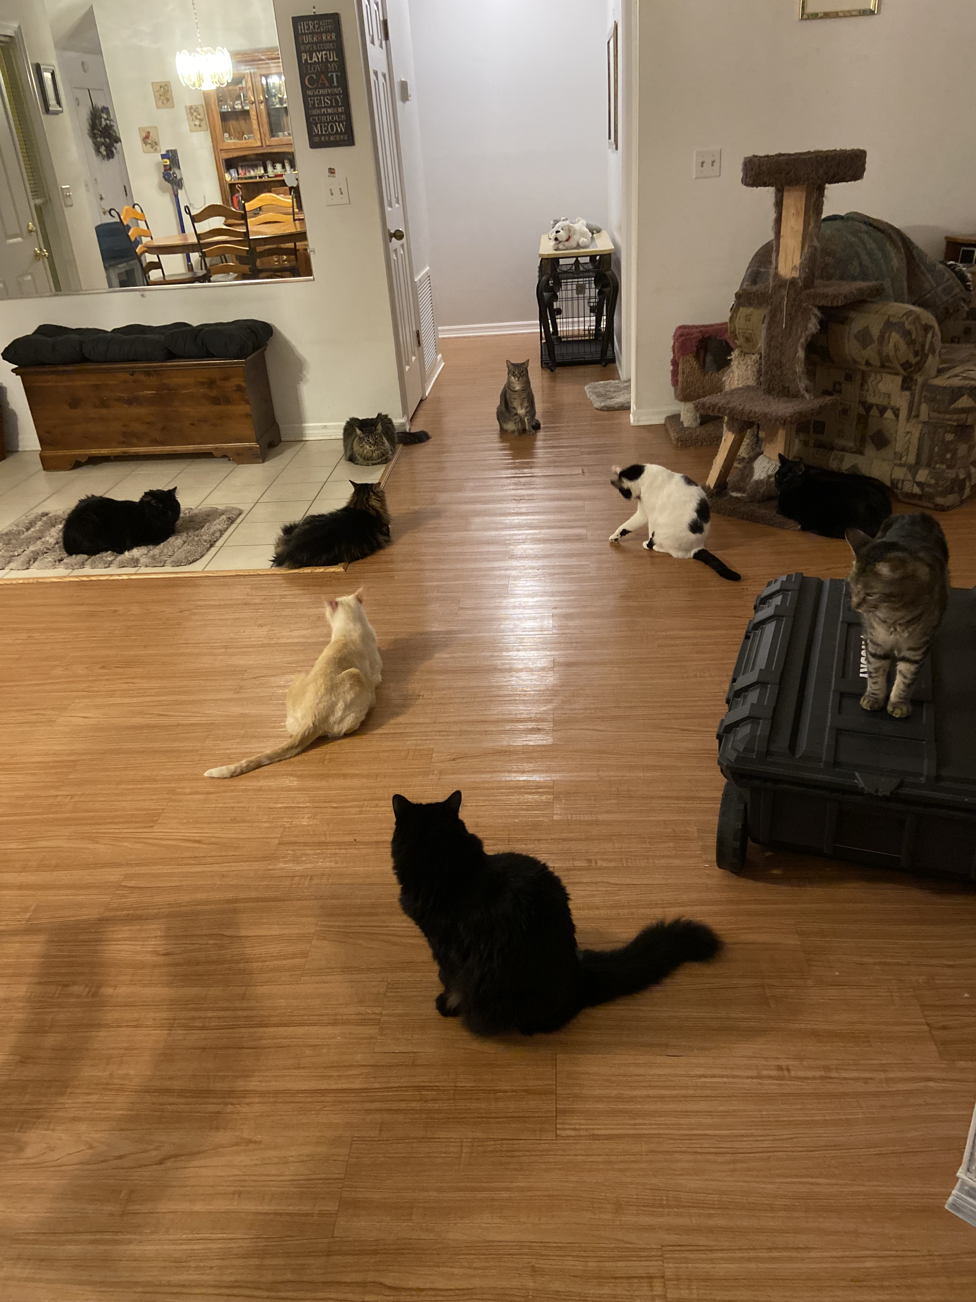
Is this your Department Meeting? Faculty Cats in Conflict
The parliamentarian faculty cat who doesn't listen well, but who expects everyone else to do so
The too-good-for-this-meeting faculty cat. She's too important for all this
The faculty cats who annoy everybody
The tired, sleepy faculty cat
The Chair cat who prepares carefully. She is very brave in leading this group
The Associate Chair cat and his plans
The competitive faculty cats having hissy fits. The Chair must respond! Disciplinary letters!
The almost always absent faculty cats
Just a little humor. It helps.

Slide 5
The Why of Conflict: Causes of Conflict*
Competition: for gain
Diffidence: for defense
Glory: for reputation
*These are Thomas Hobbes’s “Causes of Quarrel” from Leviathan, Ch. 13, 1651.

Slide 6
Sources of Competition in Conflict: These Sometimes Intersect
Professional
Disagreements about (or with):
curriculum matters;
student progress;
award programs;
Promotions and progress;
university or college administration;
what somebody's job is (or isn't)
Personal
Disagreements about:
"Attitudes"
Demeanor
"Looks"
Gossip, and spreaders of gossip
And a host of other causes

Slide 7
The Sources of Diffidence/Distrust and Self-Protection in Conflict
Personal
Perception of disrespect
Worry over contingent positions
Lying or misrepresenting facts for self-protection
And a host of other sources
Professional
Feelings of professional inadequacy, or believing others will think this
Imposter Syndrome
Hierarchical position in an organization
Dislike among people
Disagreements about deeply held convictions
Don't forget institutional sources, such as but not limited to:
Pay disparities
Differential treatment, or perceptions of differential treatment
Lack of understanding of institutional rules, policies, regulations

Slide 8
The Source of Conflict with Glory/Reputation
Professional
In promotion decisions
In annual evaluations
In award programs
In disciplinary actions
In loss of position
In perception of respect of colleagues and supervisors
Personal
From gossip and questionable accusations
From perceptions of different treatment of colleagues by administrators
From public statements about a person's professional progress or activities
From suspicious people who think there are peculiar conspiracies among their peers or administrators

Slide 9
Managing Conflict as Chair or Director
What is your take on contacting someone for help with managing conflict?
Does it make you seem ineffective if you ask for help from your contract compliance office, from the Dean's Office, from the Equity Office, or from your chair/director colleagues?
Does it make you seem incompetent?
Does it make you seem that you have lost control of your unit?
THE ANSWER IS "NO" TO ALL OF THESE. We're in this together. When in doubt, ask for help. If you haven't "been there and done that," someone else has. And even if you have been there and done that, every case is a bit different from every other.

Slide 10
Managing Conflict: It’s the Most Fun You Can Have Without Laughing
How can you help to avoid conflict? And what if you can't do anything to stop it?
Maintain an atmosphere and culture of clear communication in your unit
Communicate often with your unit members both as a group and individually
Often, a feeling that there's trouble brewing is good indication that it is.
Other times, you will be completely blindsided by it
But don't despair. You can't fix everything, and sometimes you just have to move on. And sometimes, conflict can be productive.
How can you manage conflict, and what does that mean? Who will help you, the "manager"?
You can deal with it yourself. Usually possible.
But, you have institutional support, so find it:
Contract compliance office
Deans and Associate Deans
Seek the advice and counsel of other chairs and directors
Take care of yourself; you can't always do this alone.
Especially as a "new" Chair or Director
There are things you don't know, even as an "old" Chair or Director.
"Resolving conflict isn’t about figuring out who is right and who is wrong. It’s about making the department better" (George Justice, "Managing Conflict as a Department Chair," Chronicle of Higher Education, May 13, 2021).

Slide 11
The Benefits of Conflict
If Federalist 10 (James Madison) might be a rough guide, "factions" can create problems, but they can also be beneficial:
Snuff out factions, and limit liberty (academic freedom)
Control effects of factions, which is impossible and undesirable.
Managing Conflict with Benefits
Encourage, model, and promote civility, honor, disagreement, toleration, compromise, cooperation*
Ensure that all "factions" have equal or equitable opportunity to make their voices heard
A strong but neutral leader and good organizational structure can keep factions at bay without silencing them
Different ideas tend under the best circumstances to lead to better ideas and practices.
AND
J.S. Mill, On Liberty, Ch. 2: Silencing Ideas and Disagreements is a Bad Idea
True, and lose it
False, and no chance to defeat it
Combination, and still lose both benefits
Absolutely true, or accepted, and turns to dogmatism and lack of opportunity
*See C.K. Gunsalus, et al., "Challenged Academic Units," Inside Higher Education, Apr 25, 2018.
"When you are a unit’s leader, consciously model the ways in which you wish for others to treat you and each other, as well."

Slide 12
Ending Conflict
By solving the problem
Gaining and maintaining the trust of those who report to you
Addressing obstreperous behavior when it occurs
Mediating simply by listening to those experiencing conflict
Talking to your direct reports individually at least once or twice a year regarding their progress, concerns, and plans
Make sure they know they matter to you
Make sure YOU know that YOU matter, too
By recognizing that it can't be solved; but you can move on and it can often be minimized
Letters of counsel, instruction, reprimand
Noting in annual evaluations how conflict has affected adversely the performance of a person in that person's position (teaching, admin support, etc.)
Referring employees to an Employee Assistance Program
Appropriately monitoring behavior consistent with CBA requirements. READ THE CBA.

Slide 13
Improving and Maintaining Morale in the Face of Conflict: Faculty and Staff – Common Sense
Recognize achievements
Know your faculty and staff in more than a cursory way
Participate in unit activities
Create and maintain a unit culture of respect for support staff
Universities don't run on administrators and faculty alone. Don't forget that.
Listen to them and do something about it when they tell you someone treated them in a shabby way. Encourage discussion among those people; meet with them together to help solve the problem
Follow through on your promises and commitments
Encourage and model civil discussion and cooperation
It may reduce or eliminate competition, distrust, and perceptions of disrespect
React to incivility and lack of cooperation by addressing it appropriately
In department meetings
Individually
Between disputing parties
Perhaps most of all, morale is improved and maintained when conflict is managed well, minimized, and even sometimes optimized by using its benefits for the good of the unit.

Slide 14
Give Yourself a Break: Your Morale Counts, Too
This is Important Advice:
Take my advice. I'll try taking it, too.
You are not chair, director, department head all the time. Go home and hug somebody, or your cat.
Have a friend you trust who understands you and what you do, and with whom you can confidently and confidentially express happiness, sadness, frustration, and with whom you can both commiserate and celebrate.
Thank that friend for being there and listening to you. Thank them back by being there and listening to them.
Practices for having a (more) pleasant day at work:
Ask for help when you need it. Your administrative staff and the dean's office - they know stuff.
Make friends with other chairs and directors. They know lots of stuff, too.
Take time for lunch. Get out of your office every now and then.
Laugh at the weird things you have to do every day.
Take an annual leave day or two every now and then and a real vacation at least once a year.

