Slide 1

Leadership
StePPING INTO THE LEADERSHIP ROLE

Slide 2
Takeaways
Be a leader, not just a manager/administrator
What you do as chair matters
See the big picture
Communication is essential
Relationships are critical

Slide 3
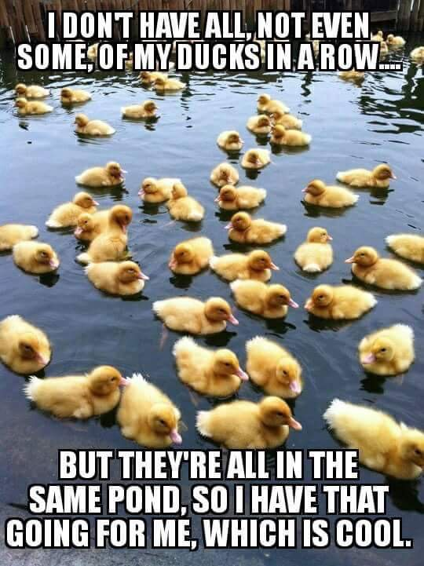
Keeping your ducks in a row

Slide 4
Developing Yourself as a Leader
How do you lead those who may not want to be led?
How do you lead those who are hungry for direction?
How do you negotiate a department that has both?
What does leadership look like:
  From your perspective?
  From the faculty’s perspective?
  From the Dean’s perspective?

Slide 5
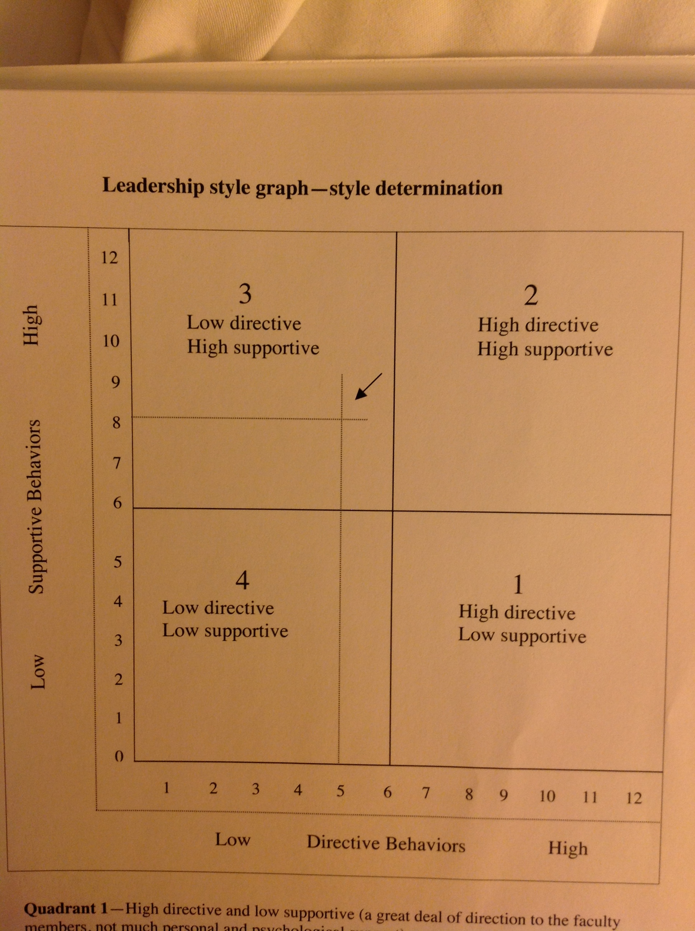
Your leadership style
Identify your style.
Your style will influence your interactions.
Your style will influence your decision-making skills.
Your style can help develop your technique.
You can’t copy someone else’s style.

Slide 6

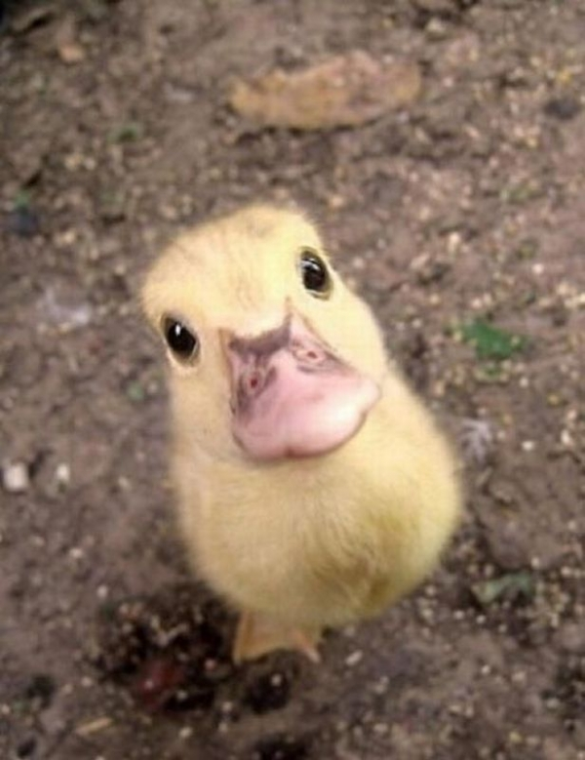
All Eyes Are On You!

Slide 7
Lead by example
Faculty will watch you….
…..and scrutinize everything you do!
what time you arrive
what time you leave
who you talk to
how you dress
how you respond to email
…and everything else you haven’t yet thought of

Slide 8
Communication is key
Listen to concerns, ideas and feedback
Be as transparent & direct as possible
Make timely (not rushed or impulsive) responses
Think before you write (remember
texts & emails are public records)
Admit mistakes
Keep notes of your actions

Slide 9
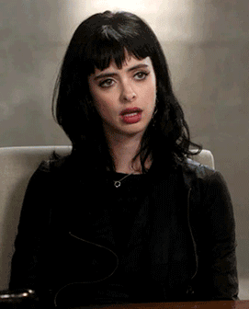
Teach your face to use its inside voice

Slide 10
Relationships are critical
If you are new…(or not)
Get to know everyone
Take time
Listen
Get off your “turf”
If you have been there…(or not)
You are the boss
Old friendships may not work the same
You can’t do this job wanting to always be liked

Slide 11

Celebrate Success!
The college
The department
The faculty
The students
It’s worth it!

Slide 12

See the BIG picture
Balance needs of department and college
Don’t rely just on favorites
Get used to wearing multiple hats
Knowledge gives you the ability to make decisions with confidence

Slide 13
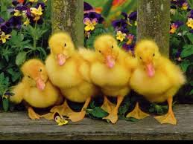
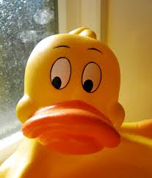
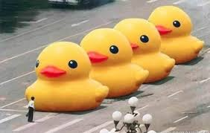
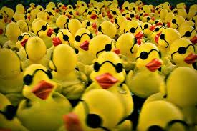
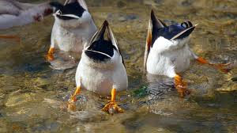
Prioritize Needs - Decide Course – Take Action
What is the department doing now?
Why are we doing it?
Can we do it better? How?
What does the dean expect?

Slide 14
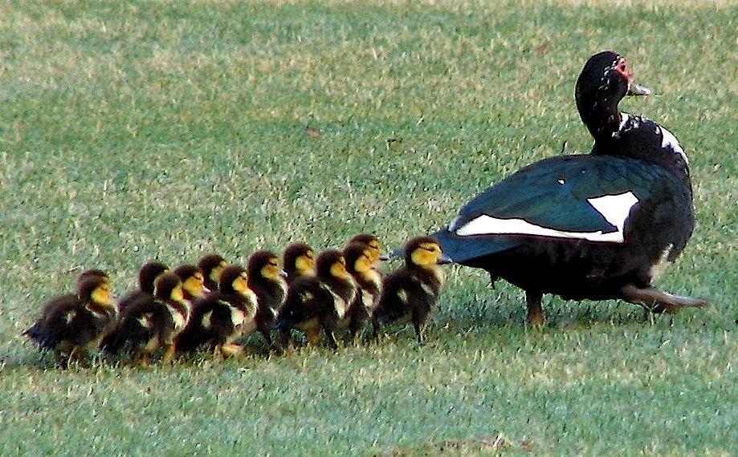
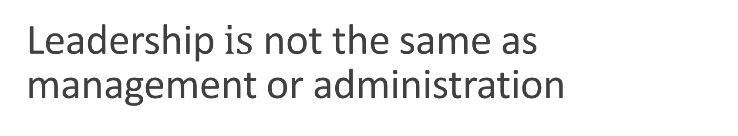
Leadership $is$ not the same as management or administration
Model the way
Inspire a shared vision
Challenge the process
Enable others to act
Encourage the heart
*Taken from “The Leadership Challenge: How to Make Extraordinary Things Happen in Organizations” by J.M. Kouzes & B.Z. Posner, 6th ed. (Hoboken, NJ: John Wiley & Sons, 2017).

Slide 15
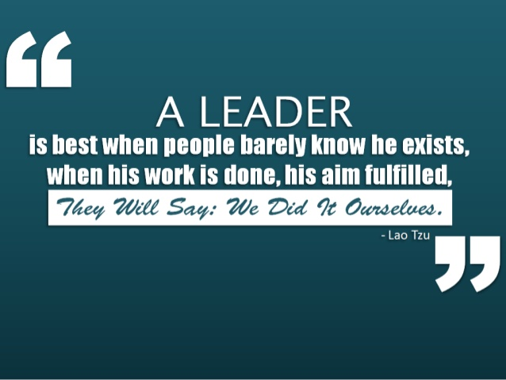

Slide 16

Even though you may sometimes feel you might be running against the wind!
http://www.youtube.com/watch?v=aCA-r3YCkUo

