Slide 1
HB 7 discussion
IAL
June 2022

Slide 2
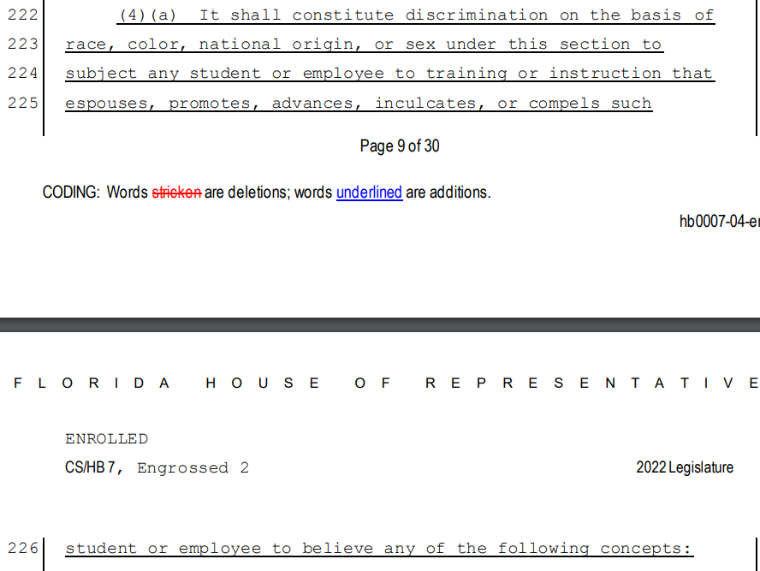

Slide 3
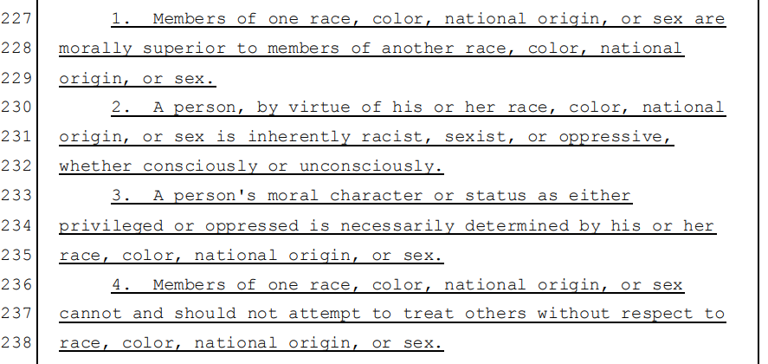

Slide 4
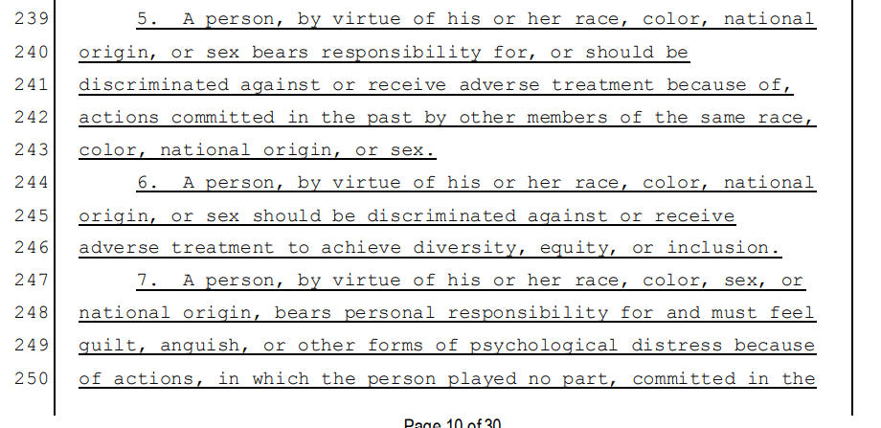

Slide 5
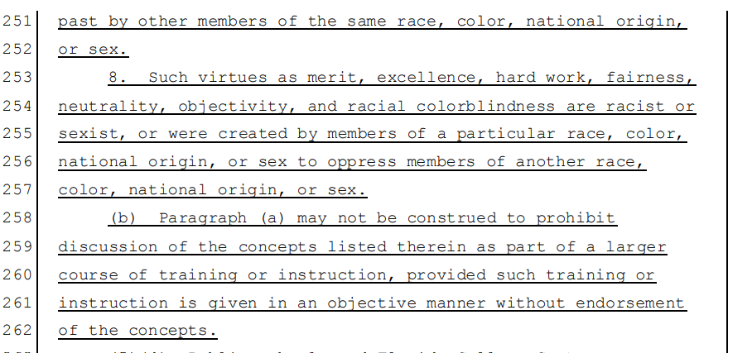

Slide 6
UF presentation for instructors: Understanding House Bill 7
the HB 7 Presentation link: https://media.coip.aa.ufl.edu/public_live/hb7/presentation_html5.html

