Slide 1
Changes to the BOG Performance Model and some observations on graduation rates in different majors
This is a brief review of some changes to the BOG Performance Model and some national data on STEM and Non-STEM students who do and do not change majors prior to graduation along with a more detailed look at a SUS example.

Slide 2
Performance-based Funding Model Changes
SB 4 Higher Education
Issues
Changes to grad rates and access rate will need to be effective for the allocation of 2018-19 funds.
By October 1, 2019, the Board of Governors, in consultation with the state universities, shall submit to the Legislature recommendations for future consideration on the most efficient process to achieve a complete performance-based continuous improvement model focused on outcomes that provides for the equitable distribution of performance funds.
In addition to recommendations submitted by the Board of Governors, the Legislature shall review recommendations from an independent entity that consults with the Board of Governors for the purpose of receiving input on behalf of the state university system.
Implementation of any recommendations shall not occur unless affirmatively enacted by the Legislature.

Slide 3
Performance Metric 4*:Four Year FTIC Graduation Rate
This metric is based on the percentage of first-time-in-college (FTIC) students who started in the Fall (or summer continuing to Fall) term and were enrolled full-time in their first semester and had graduated from the same institution by the summer term of their fourth year.
FTIC includes ‘early admits’ students who were admitted as a degree-seeking student prior to high school graduation. Source: State University Database System (SUDS).
BOG Scoring Benchmarks: 50% (10 points) to 38.8% (1 point)
* Board of Governors 2018 Performance Metrics

Slide 4
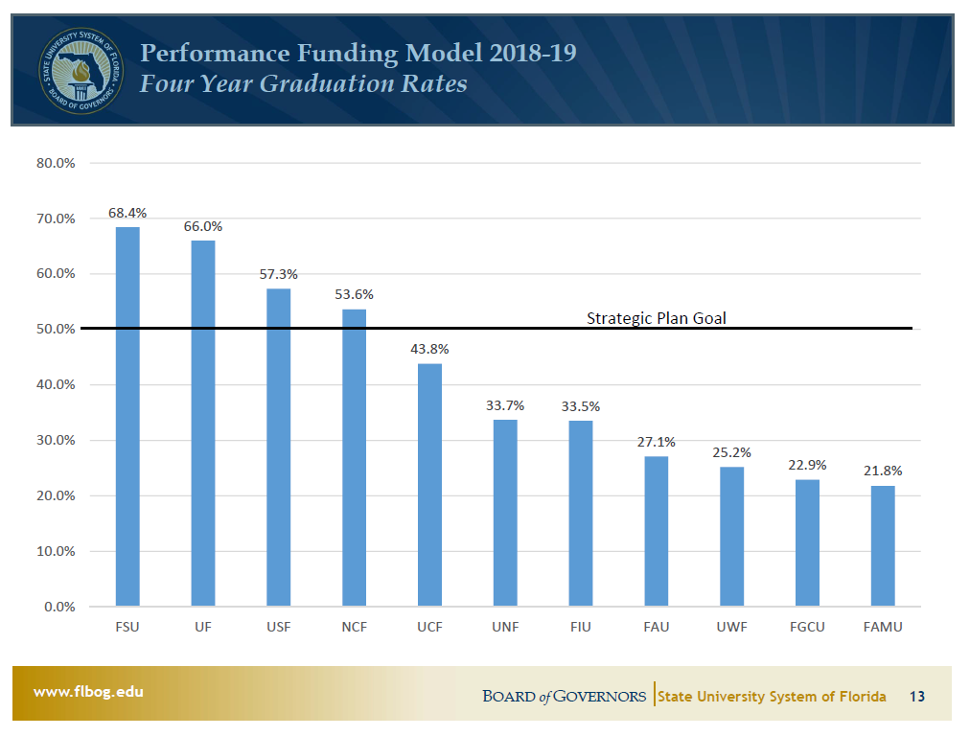
A look at where we are

Slide 5
Status of all students six years after entering a four-year public institution*
State | Total Completion Rate | First Completion at Starting Institution | First Completion at Different Institution (Anywhere in U.S.)† |  | Still Enrolled (at Any Institution) | Not Enrolled (at Any Institution)
 |  |  | Four-Year | Two-Year
U.S. Overall | 64.7% | 53.5% | 7.8% | 3.4% | 11.1% | 24.2%
Florida | 52.5% | 44.5% | 6.9% | 1.2% | 10.6% | 36.9%
SUS | ~70%**
* Shapiro, D., Dundar, A., Huie, F., Wakhungu, P.K., Yuan, X., Nathan, A. & Bhimdiwali, A. (2017,
December). Completing College: A National View of Student Completion Rates – Fall 2011 Cohort (Signature Report No.
14). Herndon, VA: National Student Clearinghouse Research Center.
**Estimated by the BOG.

Slide 6
Status of all students six years after entering a four-year public institution*
State | Total Completion Rate | First Completion at Starting Institution | First Completion at Different Institution (Anywhere in U.S.)† |  | Still Enrolled (at Any Institution) | Not Enrolled (at Any Institution)
 |  |  | Four-Year | Two-Year
U.S. Overall | 64.7% | 53.5% | 7.8% | 3.4% | 11.1% | 24.2%
Florida | 52.5% | 44.5% | 6.9% | 1.2% | 10.6% | 36.9%
SUS | ~70%**
* Shapiro, D., Dundar, A., Huie, F., Wakhungu, P.K., Yuan, X., Nathan, A. & Bhimdiwali, A. (2017,
December). Completing College: A National View of Student Completion Rates – Fall 2011 Cohort (Signature Report No.
14). Herndon, VA: National Student Clearinghouse Research Center.
**Estimated by the BOG.

Slide 7
Status of exclusively full-time students six years after entering a four-year public institution*
State | Total Completion Rate | First Completion at Starting Institution | First Completion at Different Institution (Anywhere in U.S.)† |  | Still Enrolled (at Any Institution) | Not Enrolled (at Any Institution)
 |  |  | Four-Year | Two-Year
U.S. Overall | 84.05% | 74.19% | 7.85% | 2.02% | 2.33% | 13.61%
Florida | 82.67% | 74.40% | 7.38% | 0.89% | 1.22% | 16.12%
SUS | ?
* Shapiro, D., Dundar, A., Huie, F., Wakhungu, P.K., Yuan, X., Nathan, A. & Bhimdiwali, A. (2017,
December). Completing College: A National View of Student Completion Rates – Fall 2011 Cohort (Signature Report No.
14). Herndon, VA: National Student Clearinghouse Research Center.
**Estimated by the BOG.

Slide 8
Senate Bill 4:BILL ANALYSIS AND FISCAL IMPACT STATEMENT*
Graduation rates are one of the key accountability measures that demonstrate how well an institution is serving its FTIC students. On-time graduation in 4 years with a baccalaureate degree may result in savings related to cost of attendance for students and their families. For example, nationally, every extra year beyond 4 years to graduate with a baccalaureate degree from a public 4-year college costs a student $22,826. This may also result in lost wages owing to delayed entrance into the workforce. The median wage of 2013-2014 baccalaureate degree graduates employed full-time one year after graduation was $38,000.
*http://www.flsenate.gov/Session/Bill/2018/4/Analyses/2018s00004.pre.ed.PDF

Slide 9
How to reduce the cost of college*
The best approach to reducing the cost of college is to ensure that each students earns 30 credits a year taking only those credits required for the degree in order to graduate in four years.
Each year beyond those required is very expensive:
    Subtotal: $22,826
    Lost opportunities: $38,000 is the average salary of bachelor graduates a year after graduation.
    Additional interest on any student loans.
Adding all of the costs, including loss of employment and retirement benefits, can result in a lifetime loss of more than $147,000 for each additional year of college.
*https://www.consumerreports.org/student-debt/surprising-way-to-limit-student-debt/

Slide 10
Factors significantly improving graduation rates*
Completing math and English requirements the first term.
Completing 30 credit hours the first year.
Having a four-year Academic Map with Milestone courses.
Proactively advising students who are “off-map.”
Completing three courses related to the major during the first year.
Aligning the required mathematics courses with the major (i.e., do not require Algebra unless Calculus is also required).
*Modified Game Changers from Complete College America:https://completecollege.org/completion-roadmap/

Slide 11
Some reasons to improve graduation rates
College graduates enjoy an income advantage, a health advantage and a higher likelihood that their children will graduate from college.
The community, state and nation gain through the enhanced civic engagement and financial resources of college graduates.
The department gains students.
The institution’s Performance Metrics improve in at least two categories avoiding a financial penalty.
The institution gains significant new revenue when students remain enrolled through enhanced tuition collections.
It is the right thing to do.

Slide 12
BOG Performance Metric 6. Bachelor's Degrees within Programs of Strategic Emphasis
This metric is based on the number of baccalaureate degrees awarded within the programs designated by the Board of Governors as ‘Programs of Strategic Emphasis’. A student who has multiple majors in the subset of targeted Classification of Instruction Program codes will be counted twice (i.e., double-majors are included). Source: State University Database System (SUDS). [Includes STEM degrees.]
BOG Scoring Benchmark: 50% (10 points) to 27.5% (1 point)
* Board of Governors 2018 Performance Metrics

Slide 13
STEM Worker Shortage
Enough students with STEM degrees graduate to meet needs...BUT
“Out of every 100 students with a Bachelor’s degree, 19 graduate with a STEM degree, but only eight are working in STEM occupations ten years after graduation.”*
In 2011 STEM workers accounted for 6% of the US workforce. **
The vast majority of workers who have been trained in science and engineering are not currently working in a STEM occupation. Only 26 percent of science and engineering graduates are currently employed in a STEM occupation. Instead, they are employed in fields such as non-STEM management, health care, law, education, social work, accounting, or counseling. **
*STEM. 2011. Anthony P. Carnevale, Nicole Smith, Michelle Melton.
George Washington Center on Education and the Workforce.
**The relationship between science and engineering education and employment in STEM
Occupations. 2013. Liana Christin Landivar. American Community Survey Reports ACS-23.

Slide 14
Top five degree areas nationally*
*Table 322.10. Bachelor's degrees conferred by postsecondary institutions,
by field of study: Selected years, 1970-71 through 2015-16. NCES 2018.

Slide 15
STEM areas of longitudinal transcript study*
STEM Attrition: College Students’ Paths Into and Out of STEM Fields, NCES 2014-001, n=7,800.

Slide 16
Status of STEM majors six years after entering college*
STEM major Changed major Withdrew Graduated
                (in major)
Mathematics 26% 12% 62%
Physical sciences 28% 18% 54%
Biological/life sciences 30% 15% 55%
Engineering sciences 21% 20% 59%
Computer/information science 28% 31% 41%
* STEM Attrition: College Students’ Paths Into and Out of STEM Fields, NCES 2014-001,n=7,800

Slide 17
Status of non-STEM majors six years after entering college*
                Changed major Withdrew Graduated
                (in major)
Business 27% 23% 50%
Social/behavioral sciences 28% 17% 55%
Education 42% 20% 38%
Health sciences 35% 22% 43%
Humanities 33% 23% 44%
* STEM Attrition: College Students’ Paths Into and Out of STEM Fields, NCES 2014-001, n=7,800

Slide 18
New majors for STEM leavers*
* STEM Attrition: College Students’ Paths Into and Out of STEM Fields, NCES 2014-001

Slide 19
Demographic characteristics of students selecting biology as a major compared to all students
Biology majors (n=1,390)
All students (n=33,000)
62.6% Women
28.4% Pell
65% White
14.5% Hispanic
13.2% Black
6.3% Asian
56.4% Women
26.3% Pell
71% White
11.2% Black
9.9% Hispanic
3.2% Asian

Slide 20
Progression of students selecting biology as their major

Slide 21
Progression summary of entering biology students
The largest number of students either changed majors or withdrew from college in the first year before attempting Bio I and Chem I.
  33.5% of entering students changed majors
  9.6% of entering students withdrew
  After completing the first Milestones in the major:
  24.9% of remaining students changed majors
  5.2% of remaining students withdrew
  After completing the second Milestones in the major:
  18.9% of remaining students changed majors
  5.1% of remaining students withdrew
  Total changed majors 55%, total withdrew 15%

Slide 22
Variation in graduation rates by race and gender

Slide 23
Status of STEM majors six years after entering college*
STEM major Changed major Withdrew. Graduated
Mathematics 26% 12%
Physical sciences 28% 18%
Biological/life sciences 30% 15% 55%
Engineering sciences 21% 20%
Computer/information science 28% 31%
Current study: Biology 55% 15% 30%
Most recent data Biology** 39.3% 11.9% 56.2%*
STEM Attrition: College Students’ Paths Into and Out of STEM Fields, NCES 2014-001.
** http://www.ir.fsu.edu/researchmodels_tab/retention_graduation_by_academic_prog.aspx 2011 cohort compared to 2004 cohort,
the 56.2% includes double majors (7.6%), single biology degrees were 48.6%

Slide 24
Graduating degrees of students who left biology

Slide 25
A student’s grade in their first biology course is predictive of success in biology but not for other majors
GRADE | A | B | C | D | F | W
% graduating in biology | 68.4% | 49.3% | 27.5% | 9.8% | 7.0% | 17.1%
% graduating with any major | 87.8% | 86.1% | 74.8% | 78.0% | 40.7% | 65.7%
Source: Florida State University Institutional Research; cohorts 2004-05 and 2009-10

Slide 26
Observations
55% of these entering biology majors changed majors, compared to 30% in a national sample.
30% of entering biology students graduated with a degree in biology, compared to ~55% in a national sample.
The most recent cohort improved significantly, graduating 56.2% of majors.
83 % of students who changed majors graduated, with the largest number earning a degree in Nutrition and Exercise Science followed by Social Science, Business and Psychology.
Three factors were associated with success in a biology major as well as in other STEM majors.
  Completing an advanced math course in the first year
  Taking 15 credit hours per term, including some courses related to the major
  Grades in math (especially) and their first course in the major

Slide 27
QUESTIONS/COMMENTS

