Slide 1
Faculty Assignments
Lawrence Abele, September 2021
Notes:
Good morning and thank you for joining us.

Slide 2
Why Assignments May Be Your Most Important Activity
Assignments set the priorities for your unit, identify what is considered important and are the basis for evaluation.
Their importance requires explicit policies for assignments developed by the faculty to ensure communication and transparency. This ensures fairness and compliance with your Collective Bargaining Agreement.
Notes:
It has been many years since I was a chair, but I remember well, my first year as chair I barely knew what was expected of me regarding assignments. The longer I served as chair, the more I came to understand how important faculty assignments are. Clearly, the assignments state the values of the department and identify what the department considers important. They can also be a source of conflict. Why is she teaching less than I am? That is why I recommend that assignment policies and the assignment themselves be done in a faculty meeting, enhancing communication and emphasizing transparency. Assignments have implications that we don’t always appreciate.

Slide 3
Why Assignments May Save Money for Florida Families
A major bottleneck to graduation is lack of needed courses and graduating on time is the easiest way to reduce the cost of college.
Why is it important to reduce the cost of college? The median family income in Florida is $55,600 and the average cost of attendance is about $22,000/yr. Even with financial aid, attending college is a financial strain.
Notes:
For example, in visits to about 50 campuses with Complete College America, the lack of a required course was one of the major reasons why a student did not graduate on time. This is not trivial since it costs about $22,000 a year to attend a Florida university (or about 40% of the median family income) and extending the time in college costs the student money and lost opportunity costs. One calculation, that I admit is a bit of a stretch since it includes lost dollars by starting a 401K a year late, estimates and extra year in college costs about $147,000.

Slide 4
Your Right as Department Chair
The University [Chair] has the right to assign the types of duties and responsibilities that comprise the professional obligation.
If the employee disputes the assignment, the employee shall perform the assignment pending final resolution of the dispute.
Notes:
And remember that the Collective Bargaining Agreement of every school in Florida has language that gives the chair the right to make assignments that the faculty member must complete pending the outcome of any dispute. Of course, by discussing and handling assignments in an open faculty meeting will greatly reduce disputes.

Slide 5
Assignment Options
Assignments may be based on historical or “past practice” activities.
Assignments may be made based on a comparison of peers; it is possible to use various data set to establish teaching research standards.
Or more commonly, whatever your colleagues request.
Notes:
I have seen lots of different approaches to assignments. Some are quite casual while others follow a fairly strict set of guidelines. A common approach is to develop a set of comparisons with peer institutions and base the assignments on those comparisons, particularly if the department wishes to make changes.

Slide 6
Assignments to Effect Change
Where is your department now in terms of teaching, research, and service?
Where would you like it to be?
Where do you obtain the information necessary to make assignments to effect change?
Notes:
There will be disputes concerning the validity of the data, even though the teaching data is submitted by the institutions participating in the program and all FL universities participate to the Delaware cost study.

Slide 7
Assignments Based on Benchmarks
In this model, the faculty and chair agree on the goals that they wish to accomplish in the academic year.
Assignments may vary significantly among faculty as each individual’s strengths are maximized.
Notes:
It is possible to utilize various data sources to set assignments in teaching and research based on comparisons using some of the sources cited here.

Slide 8
Benchmarks for Departmental Goals
Sources
Delaware Study of Faculty Workload: https://ire.udel.edu/cost/
NSF sites, especially Institutional Profiles
National Research Council:
Academic Analytics
Web of Knowledge
Criteria
Objective
Comparative
Peer Institutions
Notes:
For example, here are some benchmark data on teaching from institutions classified as Research, Doctoral or Comprehensive.

Slide 9
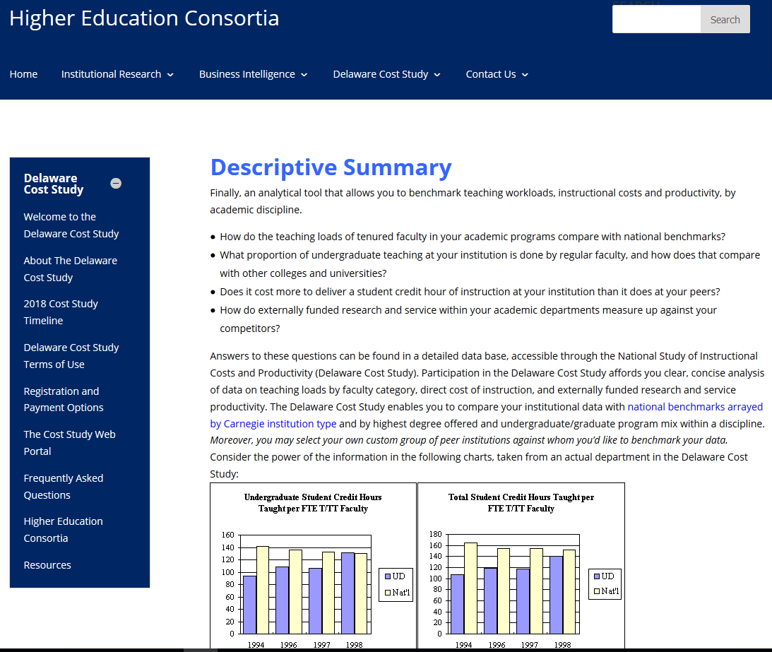
This Site allows a Wide Variety of Comparisons (All FL institutions are members)
https://ire.udel.edu/descriptive-summary/
Notes:
You and your faculty can decide your own classification as these have some flexibility.

Slide 10
Benchmark Examples (per term)
Notes:
As you can see, and probably already know, chemists teach less than humanities faculty.

Slide 11
Faculty Assignments
Teaching Economics: (example, doctoral institution)
On average, the department should offer per faculty member per term:
2.0 undergraduate courses and 0.6 graduate courses
with average enrollments of 37 undergraduate and 9 graduate
Notes:
From these and similar data, an Economics department could decide that each faculty should teach, on average, 2 undergraduate courses and 0.6 graduate courses per term and then develop a table similar to this one.

Slide 12
Teaching Assignment
Notes:
This is an approach my own department used (at least in the past) and found that it worked well and they extended the teaching assignments out two years allowing for long term planning, for such things as sabbaticals, leaves of absence or other issues that might cause a faculty member to be unable to teach a particular term. This also allowed my paranoid colleagues to see that teaching assignments were basically equitable across the two years.

Slide 13
An Easy to Use Tool (Old but still useful as the data are pretty consistent over time)
https://www.nap.edu/rdp/#download
http://sites.nationalacademies.org/pga/resdoc/
Notes:
Comparative data on research is more rigorous although disputes may still arise. At least 6 FL universities participate in Academic Analytics and many of you are probably familiar with the many options available. For many years, the National Academy of Sciences sponsored a detailed look at faculty in doctoral programs and reported a wide variety of data, such as publications per year, active grants, number of Ph.D. students and how they were supported, diversity of the students and other information. Unfortunately, the last update was in 2011 but comparing this information to other sources suggests that there is a fairly high level of consistency over time.

Slide 14
Institutional Profiles
https://ncsesdata.nsf.gov/profiles/
Notes:
You can verify this yourself through Web of Knowledge if you wish. A source that is kept up-to-date is the Institutional Profile that contains information on grants, graduate students and other information although it largely focuses on the institution.

Slide 15
Research Benchmarks: Interestingly, there has not been much variation over time
Notes:
For example, staying with Economics, about 70% of the faculty publish on any regular basis and those that do publish one paper every two years. In contrast, about 85% of chemistry faculty publish and publish about 5 papers every two years. Grant funding is often hard to come by and it usually takes three different submissions before a grant is successful. In a faculty of 15 economists, about 3-4 would be expected to have an externally funded research program and that would suggest that at least 6-12 proposals should be submitted each year.

Slide 16
Research Benchmarks (Economics- Second Quartile)
For faculty in this category, ~70% publish regularly, averaging ~ 0.5 papers per year in refereed journals.
Only 12% have active grants which means that about 36% of the faculty should be submitting proposals each year.
On average, each faculty member advises ~2.5 doctoral students.
Notes:
How these activities are distributed among the faculty should be decided at a faculty meeting, usually a very long one.

Slide 17
Research Benchmarks
Notes:
The benchmark approach has both advantages and challenges.

Slide 18
Advantages of this Approach
The data are comparative and national.
Most of the data are assembled by independent agencies.
Most of the data are not self-reported.
The evaluation and assignment involves all members of the unit.
Notes:
The advantages are that the data are mostly independent and comparative but there is little data on research in the humanities.

Slide 19
Challenges
It is often difficult to find comparative data for all disciplines.
Humanities data are often insufficient or lacking.
Data are skewed toward sciences and journal articles.
Notes:
And of course, it will take some time and effort for the department to agree on the approach that works best for your particular unit.

Slide 20
Thank you

