Slide 1
Dealing with deans
Janet Kistner
FSU

Slide 2
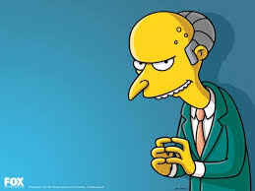
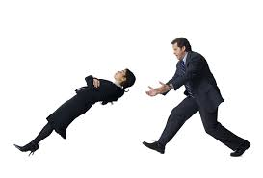
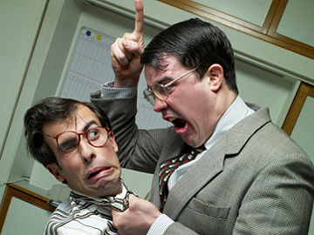

Slide 3
Complicated relationship
Chairs serve at the pleasure of the dean
Deans control chairs’ evaluation, salary, etc.
Deans control resources to departments
Bottom line: You can’t afford to have a bad relationship with your dean

Slide 4
Empowerment: dean depends on your success
Deans need to impress their “bosses”
serve at the pleasure of the provost/president
judged by effectiveness in meeting goals
most importantly – a flourishing, successful college
Success of a college depends on the success of its departments
Effective chairs are critical for successful departments

Slide 5
Tips for Building Effective Relationships with Deans

Slide 6
#1 DO YOUR HOMEWORK
Find out what are the priorities of your dean?
What did the dean do before being named your dean?
What does your dean want to accomplish?
Career aspirations?
What expectations does the Provost have of the dean?
Align priorities to benefit your unit
Notes:
May seem manipulative – and it is – but not malicious. Helps your unit be successful, and helps your dean be successful.

Slide 7
# 2 communication is key
What’s your dean’s preferred mode of communication?
How frequently does your dean want to hear from you?
Be very careful what you “say” in public records
This Photo by Unknown Author is licensed under CC BY-NC-ND

Slide 8
# 3 BE THE BEARER OF GOOD NEWS
Keep your dean informed of successes in your unit
Regularly (e.g., monthly “good news” email)
Reflects well on you and your unit
Helps your dean: “Pearls” to share with others
When you have SPECTACULAR news
Make sure the dean is the 1ST to know
Make sure the dean hears it from you
This Photo by Unknown Author is licend under CC BY-NC
This Photo by Unknown Author is licensed under CC BY

Slide 9
# 4 Never let your dean be blindsided
How much of your “dirty laundry” should you share with your dean?
How do you prevent your dean from being blindsided?
Need to find the right balance
This Photo by Unknown Author is licensed under CC BY
This Photo by Unknown Author is licensed under CC BY-SA-NC
Notes:
If it’s going to end up on the provost’s or president’s desk (or email) or make it into the paper (or a social media equivalent) – give the dean a heads up. If it involves violations of the law (e.g., financial mismanagement) tell the dean ASAP. If you feel that immediate action is needed to avert a tragedy/disaster and you need the dean’s help – contact ASAP. Short of that – dean does not need to know your unit’s “dirty laundry”. Better not to know – don’t gossip with the dean (OK if the dean gossips with you – but don’t reciprocate).

Slide 10
# 5 USE THE DEAN’S TIME WISELY
Send an agenda in advance of the meeting
Come to the meeting prepared (data, spreadsheets, etc.)
Be clear about your desired outcome
This Photo by Unknown Autor is licensed under CC BY-NC

Slide 11
# 6 Don’t let your budget go in the “red”
Headed for a budget shortfall?
Alert your dean ASAP
Provide a detailed explanation
Have a plan for getting back in the black
This Photo by Unknown Author is licensed under CC BY-SA-NC
This Photo by Unknown Author is licensed under CC BY-NC-ND
Notes:
Check your financial statements frequently and be on very good terms with the college’s budget person.

Slide 12
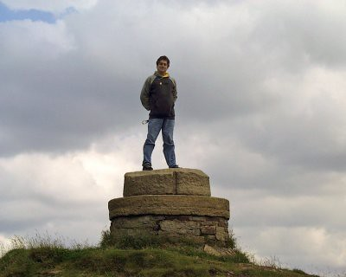
# 7 Present your dean in a good light
Foster positive relationships between your dean and your faculty
Highlight the ways in which your dean supports your unit
Dean as “fall guy” – only if you give them a heads up
This Photo by Unknown Author is licensed under C BY-SA-NC
Notes:
Not always easy and may not reflect your feelings about the dean – but never helpful to create an “Us” against the dean situation. On occasion used the dean as the “fall guy” to accomplish some goal of important but always got the OK from the dean (usually it was at my dean’s suggestion – “Blame me”).

Slide 13
# 8 PUT SOME skin in the game
Contribute some of your own resources – shows this is a top priority
Be clear about expected ROI
Notes:
Even if you have a modest budget, offering some of your resources communicates a critical message – and greatly increases a positive response from your dean.

Slide 14
# 9 TRUST (and create a record)
Conclude meetings by summarizing agreements, next steps
Follow-up with an email: “Thanks for your time and for agreeing to……..”
This Photo by Unknown Author is licensed under CC BY-SA-NC
Notes:
Helps you and the dean – misunderstandings are common, best to confirm that you correctly interpreted what your dean said in a meeting (of course, don’t put anything in email that is confidential – remember that emails are public records). Helps too so that you and the dean remember what was agreed to weeks, months later.

Slide 15
# 10 keep the dean’s confidences
NEVER share information that was intended only for you
Even if you hear it from someone else – don’t reveal a confidence
If it’s not clear – ask!
Notes:
Can’t stress this enough – hard to recover from a mistake in this area.

Slide 16
Building effective relationships with deans
QUESTIONS?
THANKS!

